Slide 1
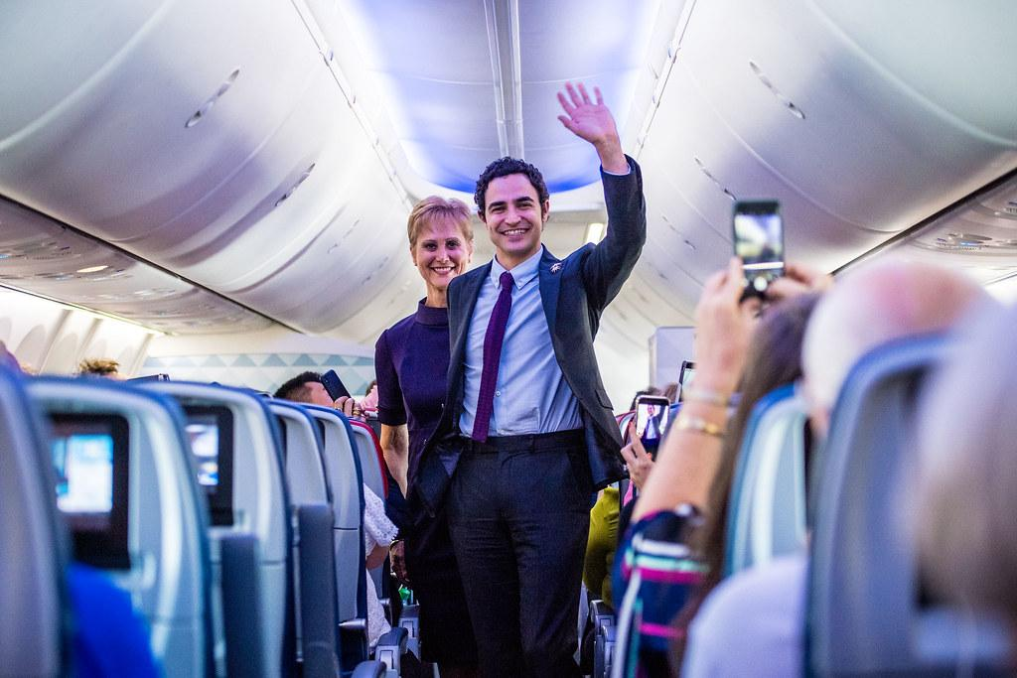
Satisfaction of
Airline Passengers
By Javier Berrios - Coding Dojo

Slide 2
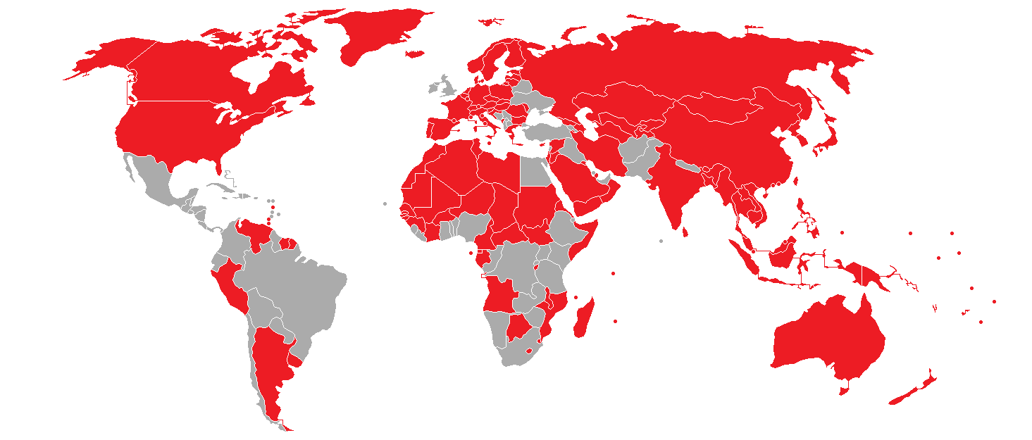

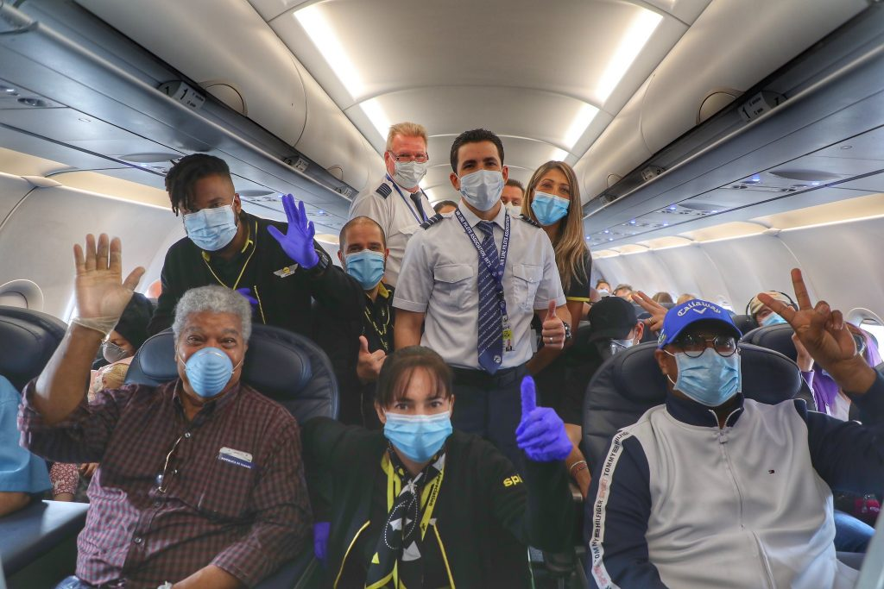
Background
Due to Covid-19 most businesses around the world have been setback, particularly hardest hit has been the airline industry, especially early on in the Pandemic as most international air travel has been grounded into the United States with the exception of the following countries that have less restrictions than others( Australia, Canada, New Zealand, and the United Kingdom).
Nonetheless the need to travel persisted, once the government allowed travel and our risk tolerance towards the virus rover, demand for air travel is expected to overflow.
The big questions is , what can the airlines do to ensure that they are prepared and have advantage against their competition when the floodgates are opened and travels return in droves? The possible answer will come from the flight satisfaction survey dataset derived the the website Kaggle to help us find key indicator of customer satisfaction
Notes:
A little background on this dataset.
As many you are aware 2020 a year of many unknowns. We all have either indirectly or directly felt the impact of the Covid-19 pandemic to our everyday life. And we’re still trying to figure things out two years later as we come to the end of 2021.
One business that was severely impacted early on in the pandemic and affected the world travel was airline industry
As our governments have come together to fight and protect our well being slowly has more people have become comfortable with travel once again
Using this dataset gathered from Kaggle website, we will try to answer some big questions that will help ensure the readiness of this airline to handle the hopefully soon boom in business once the pandemic has subsided.

Slide 3

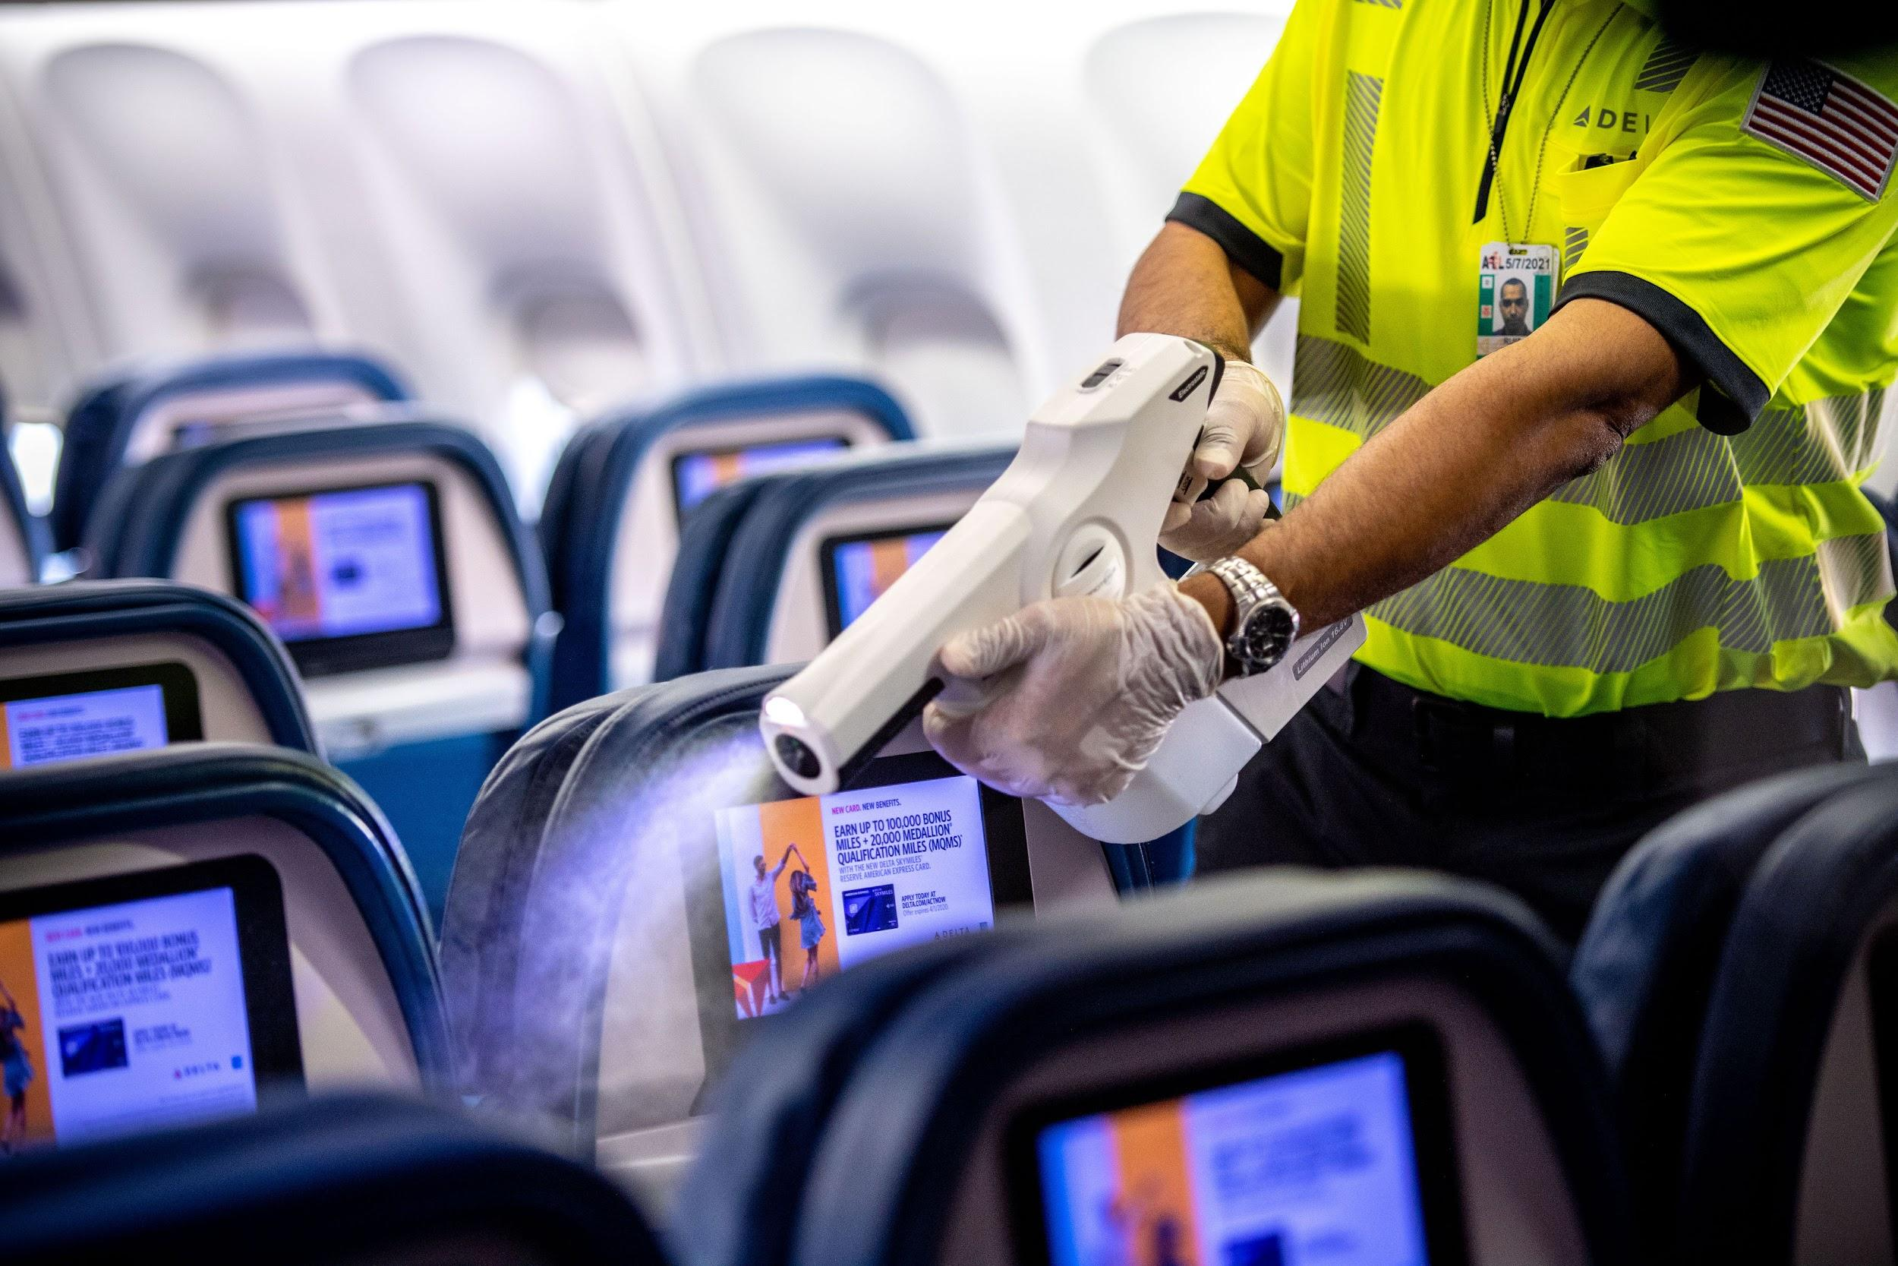
Project Objective
During this initial dive into the data we’re going to provide
PHASE 1
Data Findings
PHASE 2
Models and Evaluation
PHASE 3
Final Model and Recommendations
Notes:
PHASE 1
Data Findings
PHASE 2
Models and Evaluation
PHASE 3
Final Model and Recommendations
Introduction includes brief description of data and modeling goal (e.g. This project tries to predict y using X)
2 or more visualizations appropriate to a non-technical audience are included that describe and explain key findings in the data. (no boxplots or histograms)
Final model is described and evaluation is reported
Recommendations related to the findings and/or results of the project are included

Slide 4

PHASE 1
Data Findings

Slide 5
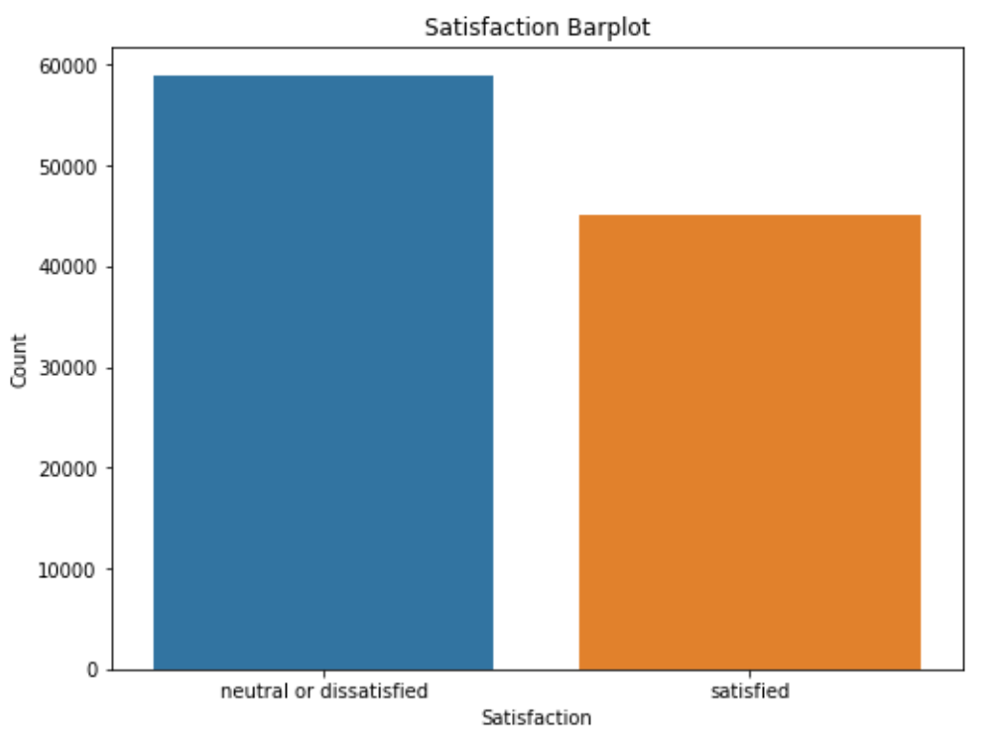
Dataset Airline Satisfaction.
Majority surveyed were either neutral or dissatisfied
Notes:
The dataset 103904 survey entries and passenger/flight details from an airline.
The majority were neutral or dissatisfied
How can we reach those who were dissatisfied

Slide 6

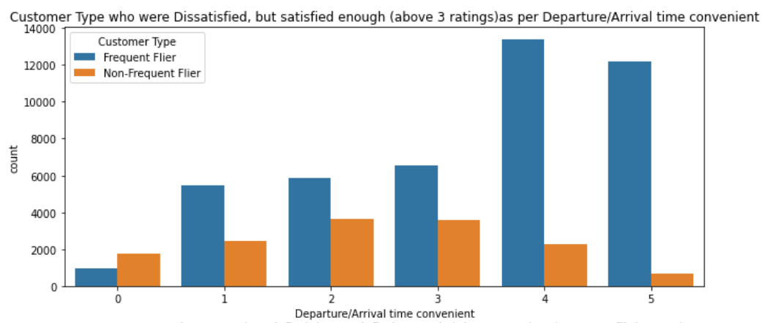
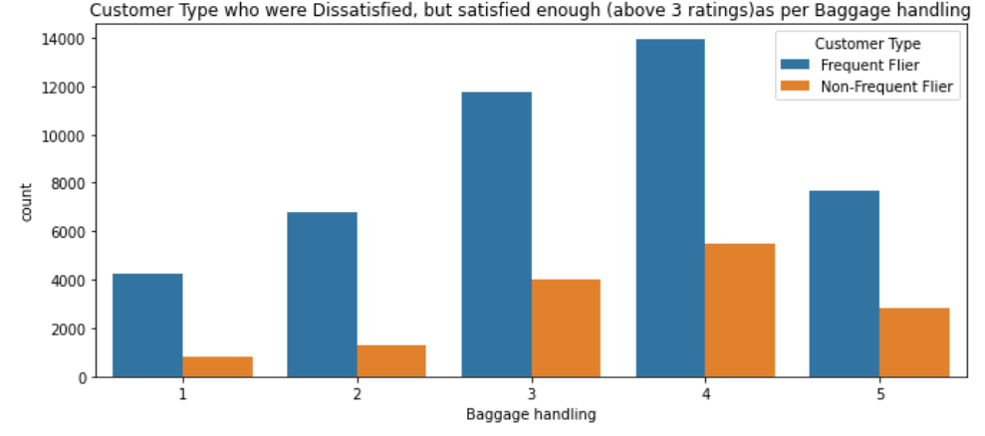
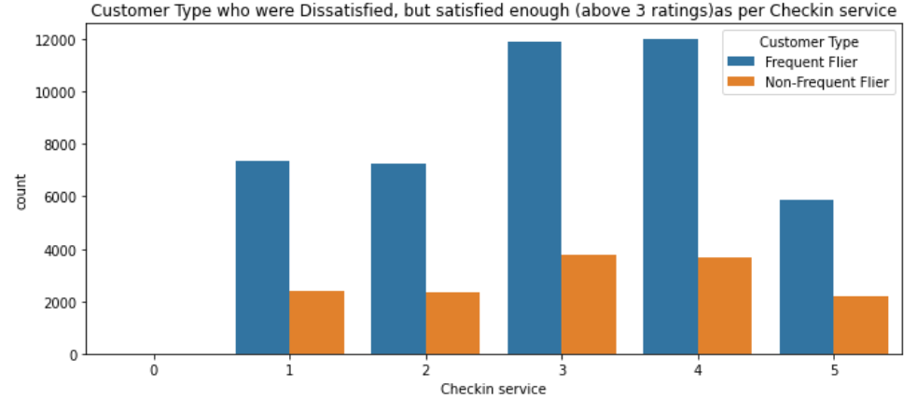
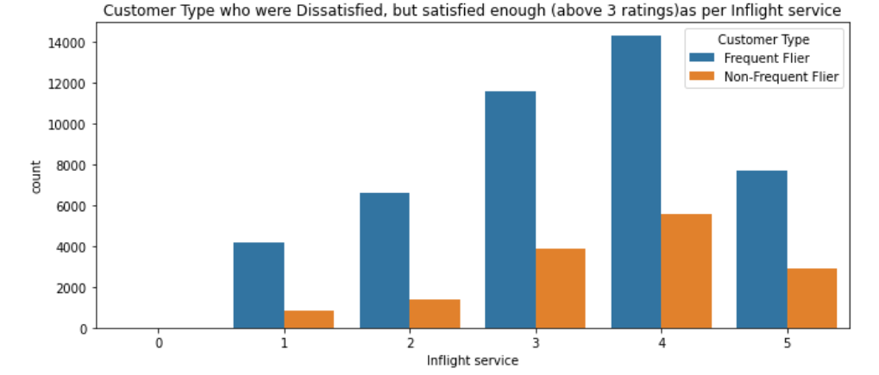
Dataset Airline Satisfaction.
Dissatisfied customers grouped into Frequent flier or Not Frequent Flier
Categories they value
Notes:
The data was then group by Customer Type, which are Frequent Flier and Non-Frequent fliers. I also drilled down further into that group to see what do they care about and what twerks them the most
They approve of the following top 4 items
(in order rating (1 being the top rated)):
Departure/Arrival Time Convenience
Check-in Service
Baggage Handling
Inflight Service

Slide 7

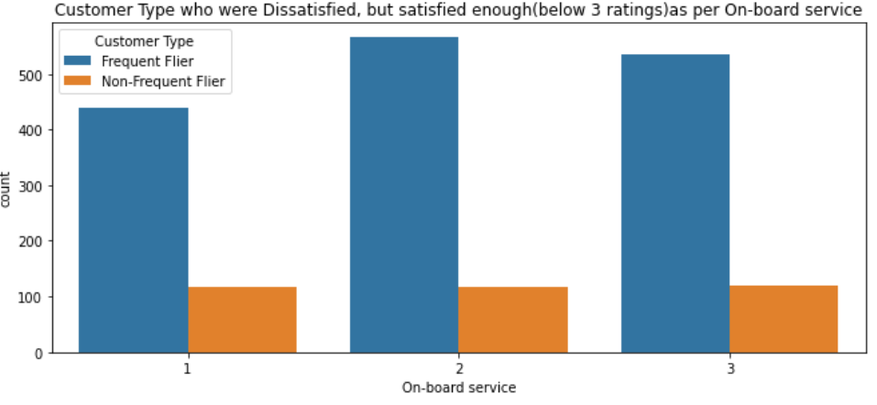
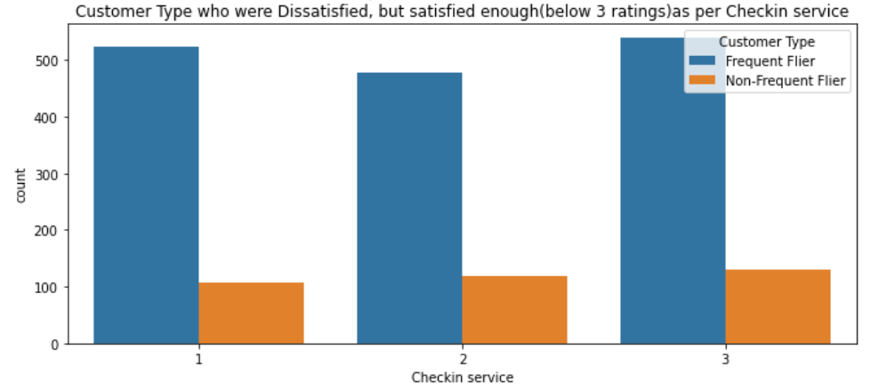
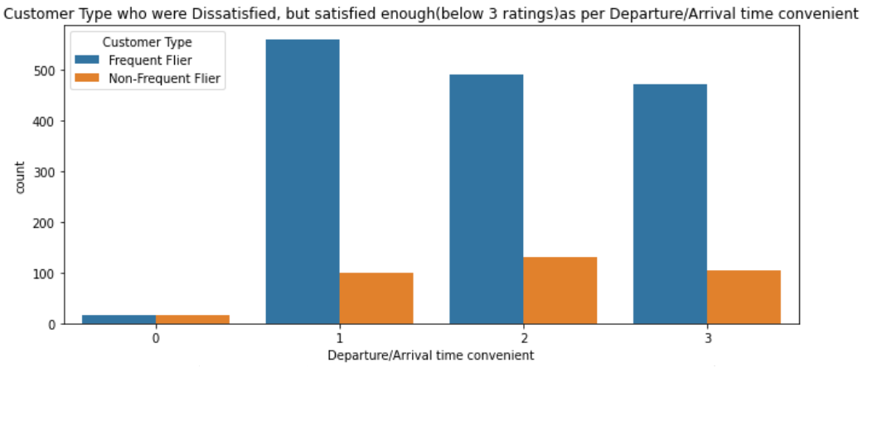
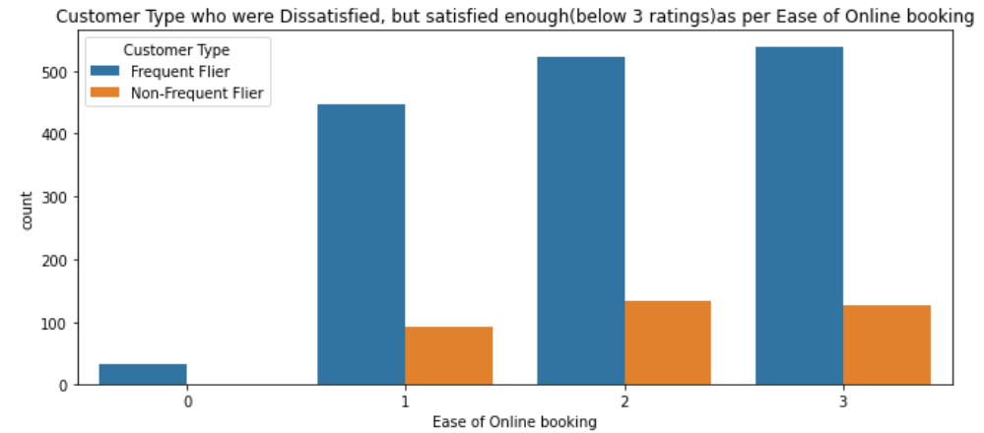
Dataset Airline Satisfaction.
Dissatisfied customers grouped into Frequent flier or Not Frequent Flier
Categories that need improvement.
Notes:
The data was then group by Customer Type, which are Frequent Flier and Non-Frequent fliers. I also drilled down further into that group to see what do they care about and what twerks them the most
They disapprove of the following top 4 items
(in order rating (1 being the top rated)):
Departure/Arrival Time Convenience
Check-in Service
Ease of Online Booking
On-board Service

Slide 8

PHASE 2
Models and Evaluation

Slide 9
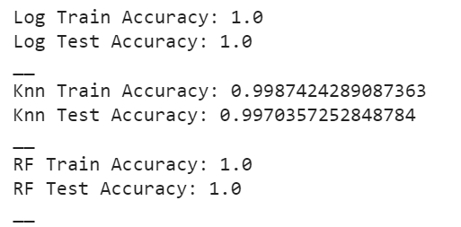
Models
In designing my models, the following were used:
Logistic Regression Classifier(‘Log’)
KNeighbors Classifier (‘Knn’)
Random Forest Classifier (‘RF’)
To further tune my models, the following were used:
Pipeline
Hyper parameters
Random Search
Confusion Matrix
Notes:
In designing my models, the following were used:
Logistic Regression Classifier(‘Log’)
KNeighbors Classifier (‘Knn’)
Random Forest Classifier (‘RF’)
To further tune my models, the following were used:
Pipeline
Hyper parameters
Random Search
Confusion Matrix

Slide 10
PHASE 3
Final Model and Recommendations

Slide 11
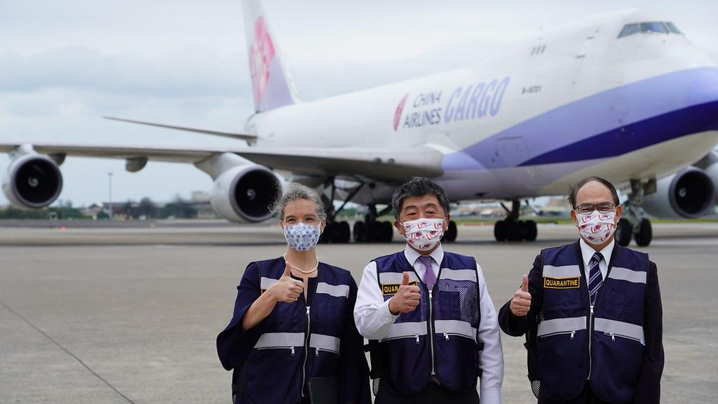
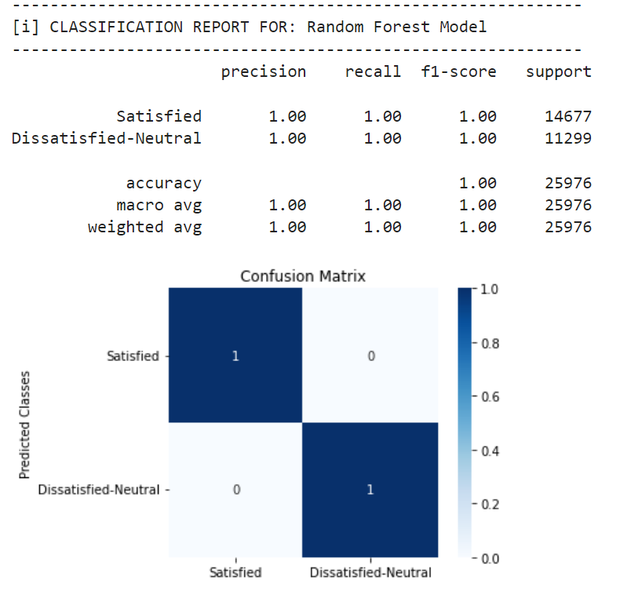
Findings
Model:
Final selection with 1.0 Accuracy - Random Forest model
Survey:
Future Surveys should have the Satisfaction column split
Review alternatives to rating/ranking system
Customers:
[PREFLIGHT]-Continued improvements on departure/arrival time options
[PREFLIGHT]-Check-In services improved
[INFLIGHT] -On-board services improved
Notes:
Findings
‘Satisfaction’ currently surveyed w/ two option (Neutral/Dissatisfied, Satisfied). The survey would best be suited to three options and splitting the Neutral and Dissatisfied as two separate option.
Rating scale columns reviewed
Likert scale
Slider Scale
Graphic Scale (Happy Faces, Stars, etc…)
https://www.qualtrics.com/blog/three-tips-for-effectively-using-scale-point-questions/
The majority of the models all scored Accuracy 1.0 across the board, which made it extra difficult to choose the best model especially between Random Forest and the KNN model. That said, we can see that the questions that were asked in the survey were well matched for this survey.
Going forward the survey lends to again, splitting the Target into thirds with Satisfaction, Neutral, Dissatisfied. Also, will focus on changing the data set to dive into other segments such as how does cat 'Gender', 'Type of Travel', 'Customer Type', 'Age' effect the Target. That would yield better results that would be more impactful to the company

